Slide 1


Capture – Photo Studio Website
Prepared By:-
Name: Manas Mehta
Roll no:109
Enrollment No:21002170110076
Batch: A4 Branch: CE
Name: Kunal H Limbasiya
Roll no:111
Enrollment No:21002170110065
Batch: A4 Branch: CE
Name: Riyazahmed N Momin
Roll no:110
Enrollment No: 21002170510016
Batch: A4 Branch:AIDS

Slide 2
Information:-
Photography studio means the workshop of a photographer, which may include the retail sale of portraits and/or photographs produced by the photographer and a photography shop
You can start with a simple backdrop, one light, a good camera with a flash, and a tripod, and you're ready to go.

Slide 3
Technologies Used:-
React.js (Helps to make components reuse)
HTML5 (Basic to create Website)
CSS3 (Extra Styling)
Bootstrap 5 (Styling and making of components)
MongoDB (To store Data)
Express.js (To connect MongoDB and React.js)
Node.js (To connect MongoDB and React.js)

Slide 4
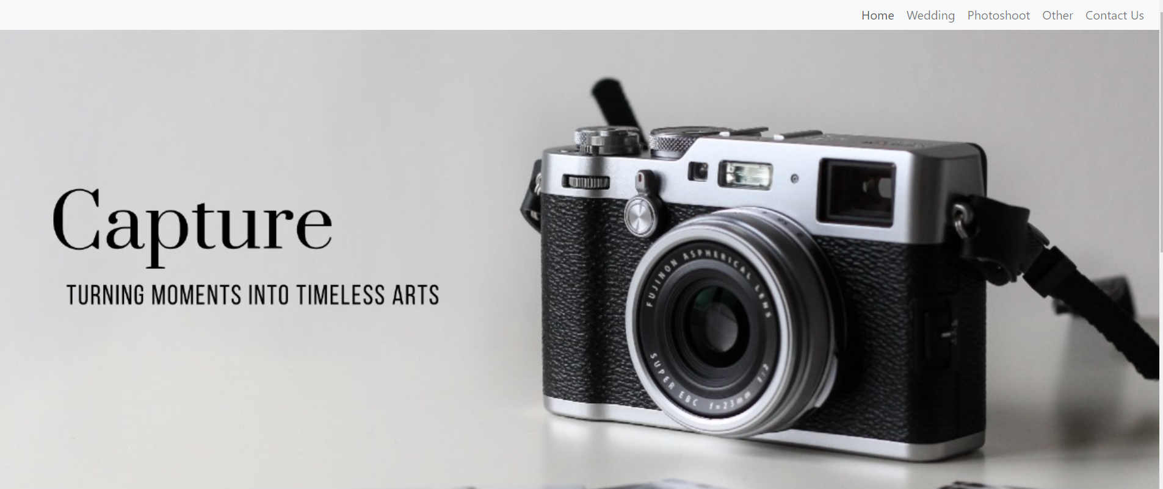
Glimpse Of Home Page:

Slide 5
THANK YOU….

